Slide 1







Electric Car Charging Station“Chargi”
Ben Arous Youssef
Yahmadi Jasser
Done By :
Ferchichi Raslen
Ben Ammar Fares
Second Year Project
(1st engineering Cycle)
Bouchakour Ala-eddine

Slide 2
Table of Content
1) Problem statement
2) Topic/theme
3) Team and project
4) Project description
5) Target audience and market
6)Competing applications & originality
1) Module and features
2) Functional & security
3) Arduino
lll Implementation
1) Work environment
2) interface
lV Conclusion
l Project presentation
ll Requirements
/1

Slide 3
Qui sommes-nous?
Nous sommes un groupe de jeunes enthousiastes et soucieux de l’avenir de l'écologie c’est pour cela qu’on a pensé à élaborer notre projet “CHARGI”.
/2

Slide 4
Problématique
Comment concevoir une application desktop efficace et facile à utiliser pour l'agence en vue de faciliter la gestion tout en permettant une automatisation des offres, une communication fluide, une gestion financière et technique optimisée ?
/3

Slide 5
Projet Description
As part of our academic training as 2A18 students, we propose to develop a desktop application to validate our course project.
Our idea, named “Smart Electric Charging Station”, aims to create a complete desktop application for managing employees, cars, charging sessions, maintenance operations, and customer complaints.
/4

Slide 6
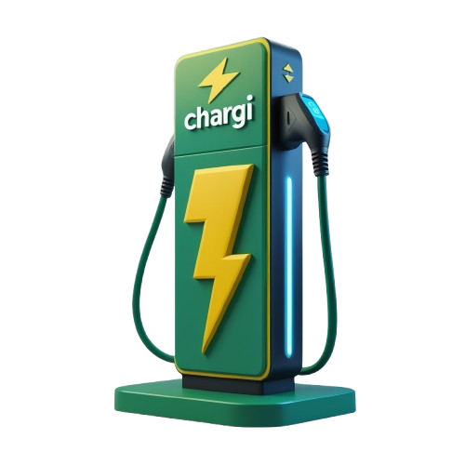
EV Charging Point Management
modules
Employee Management
Client Management
Maintenance Management
Vehicle Management
EV Charging Point Management
/5

Slide 7
Requirements
/6

Slide 8
Functional Requirements:
Our application will provide features such as client management, employee management, vehicle management, maintenance management, and EV charging point management.
/7

Slide 9
Basic Features
Display
Delete
Edit
View
Sort/Search
Generate PDF Documents
Statistics
/8

Slide 10
Employee Management:
Employee
Employee
Authentication
password initialization
Entity :
Users:
features
/9

Slide 11
Clients management
Client management
Employee
-Offer a loyalty card
-Bring back Happy Hour
Entity :
user:
features:
/10

Slide 12
Car management
car
Employee
-Car history
-Modification of the gauge during car charging with display of the duration
Entity:
Utilisateur:
features:
/11

Slide 13
EV Charging Point Management
EV Charging Point Management
Employee
-”Happy-Hour” at random times of the day .
-Charging point rest (pause when the energy supply is depleted).
Entity:
User:
Features:
/12

Slide 14
Maintenance Management:
Maintenance Management:
Employee
-Reservation (booking cars by date and time)
-Notification (when the car’s maintenance period ends, a notification will be sent),
Entity:
User:
Features:
/13

Slide 15
NON FONCTIONNELS requirements
/14

Slide 16
Security
CHARGI grants user access through a unique ID (CIN) and a securely initialized password.
Performance:
CHARGI’s system should load any page or feature within 3 seconds to ensure a smooth user experience.
Usability:
Reliability
CHARGI interface should be intuitive and easy to use for all age groups.
CHARGI offers users a smart, simple, and satisfying experience.
Ergonomics
CHARGI follows a consistent graphic design standard across all interfaces.
/15

Slide 17
Originality (Added Value)
Consommation et production responsables
CHARGI promotes the use of renewable energy sources to power its charging stations, supporting a sustainable energy transition.
Measures to Combat Climate Change
CHARGI helps reduce air pollution and greenhouse gas emissions. It also contributes to lowering electronic waste through smart
resource management.
Age Inclusivity and Equal Access
CHARGI is designed for everyone — whether young, adult, or elderly — ensuring easy and accessible use for all age groups, with no barriers or restrictions.
/16

Slide 18
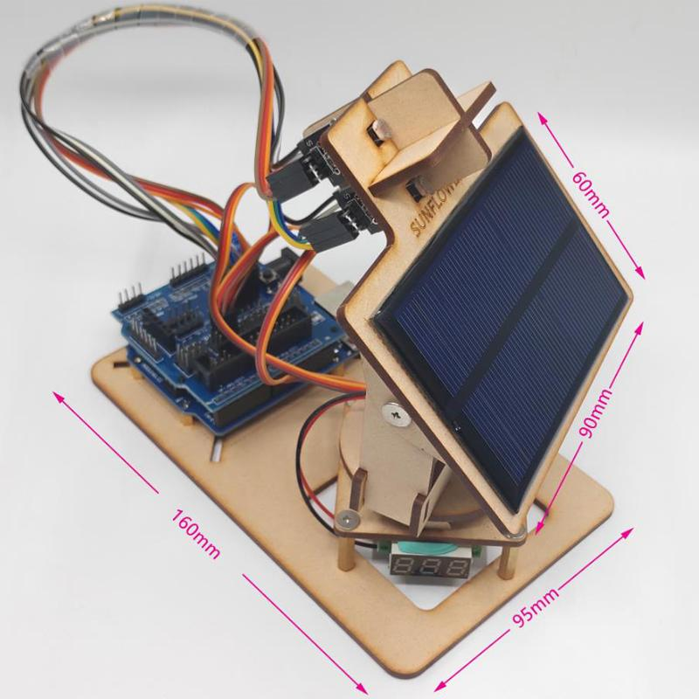
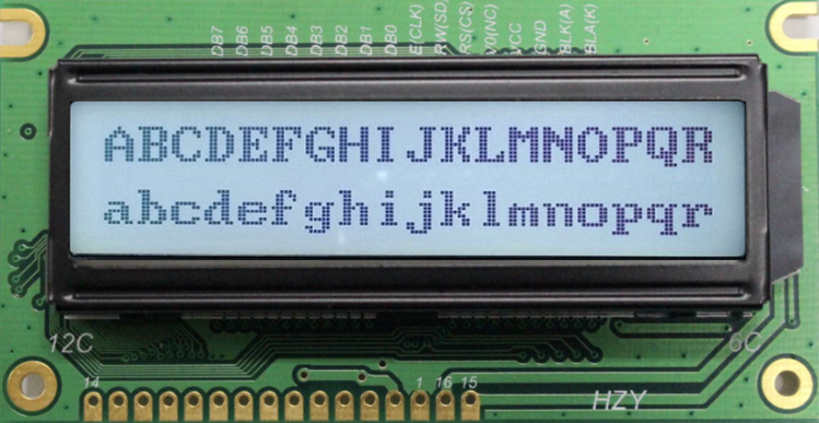
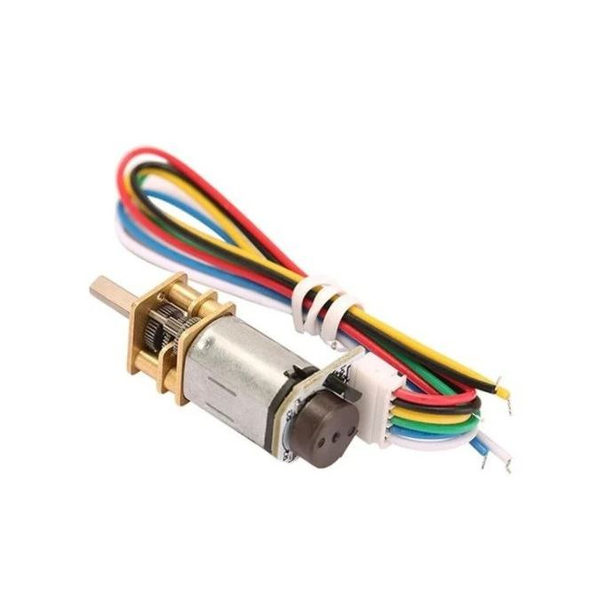
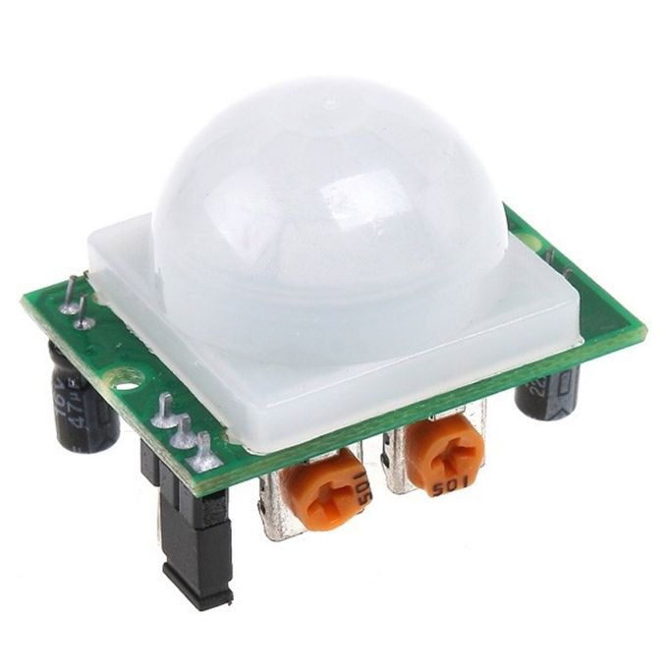

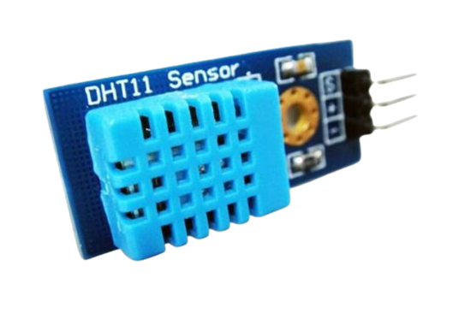
Smart Arduino
LCD display showing temperature and humidity.
Two light sensors to capture sunlight rays.
Motor to rotate the solar panel.
Solar panel to store solar energy.
LCD display showing the charging price.
LCD display showing the session status (Rest / Active).
Motion sensor with a buzzer that indicates when a car passes near the charging station.
RFID pour lire l’id de voiture a
2 Lampes ( Vert : la session est occupé de charger une voiture / Rouge : La session est en mode Repos.)
RFID reader to read the car’s ID and identify the type of maintenance (Washing / Breakdown).
LCD display showing the type of maintenance.
Two lamps to indicate the type of maintenance (Blue: Washing / Green: Breakdown).
Motion sensor to detect when a car enters the maintenance garage.
Motor for controlling the maintenance barrier.
/17

Slide 19
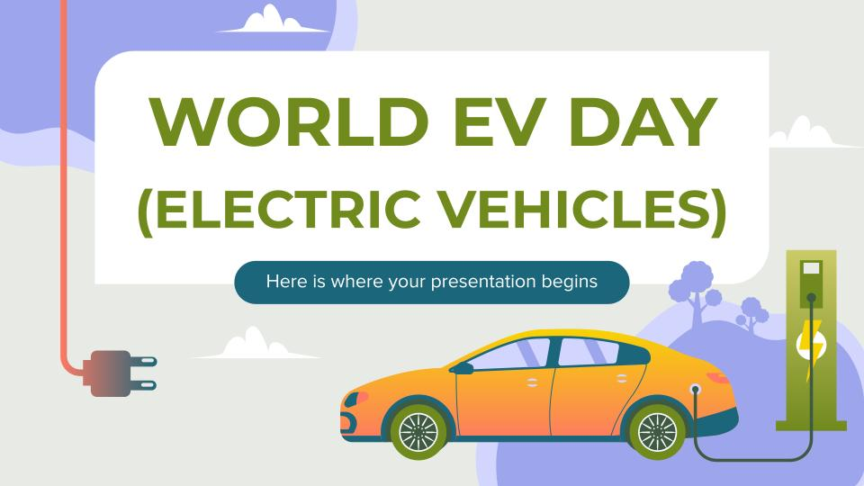
Target Audience:
The “CHARGI” application is particularly suitable for companies seeking to provide a reliable and convenient charging service for their employees, clients, or visitors.
Target Market:
The market for electric vehicle charging management software is rapidly growing alongside the expansion of the electric car market. CHARGI meets this demand by offering a customizable solution for managing electric vehicle charging.
Competitions
EV Connect
Total Energie
Shell energie
Blink Charging
/18

Slide 20
Implementation
CHARGI
/19

Slide 21

Work environment
QT 5.9.9
Oracle SQL
Arduino
/20

Slide 22
Interface
Chargi
/21

Slide 23
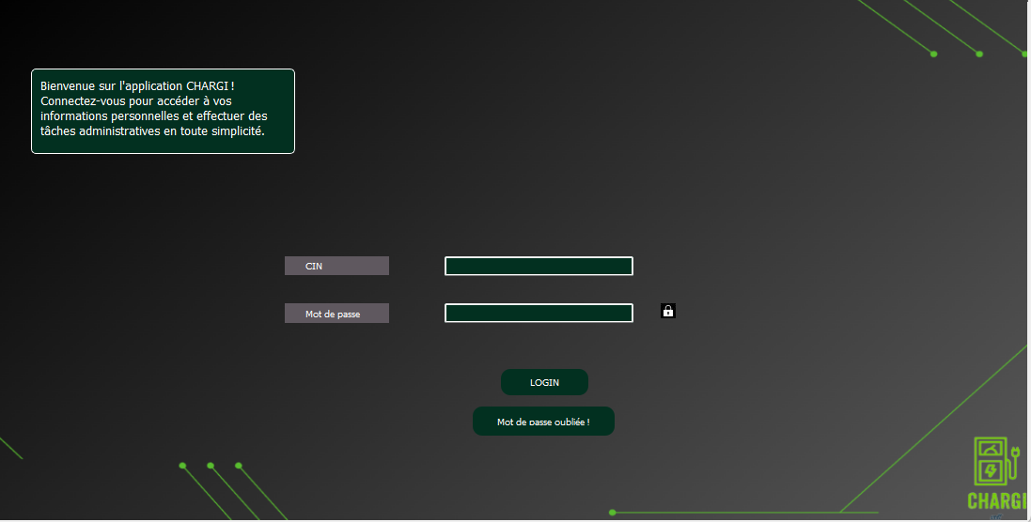
LOGIN :
/22

Slide 24
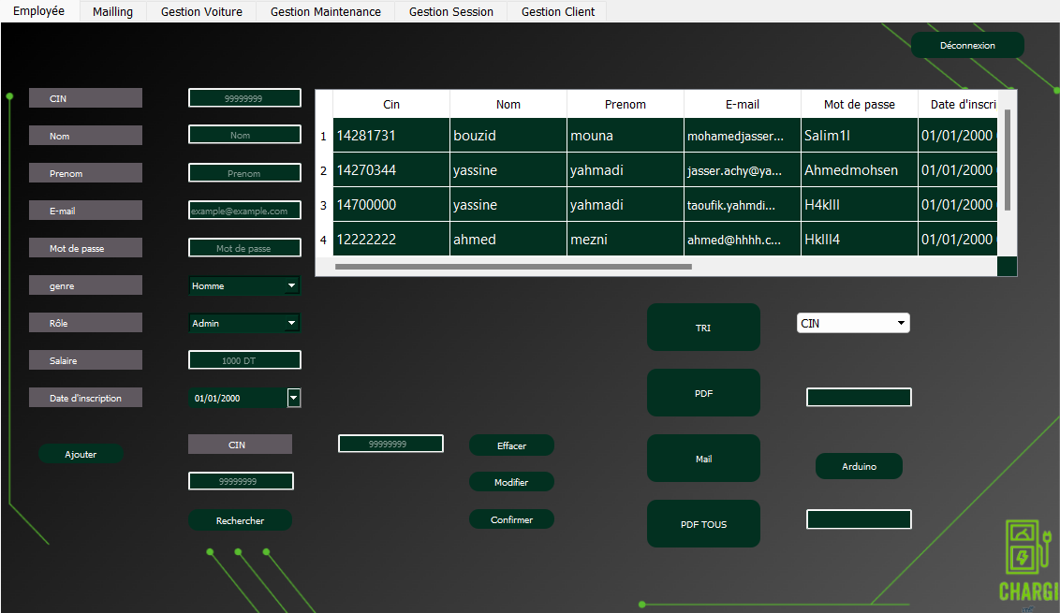
Employee Management :
/23

Slide 25
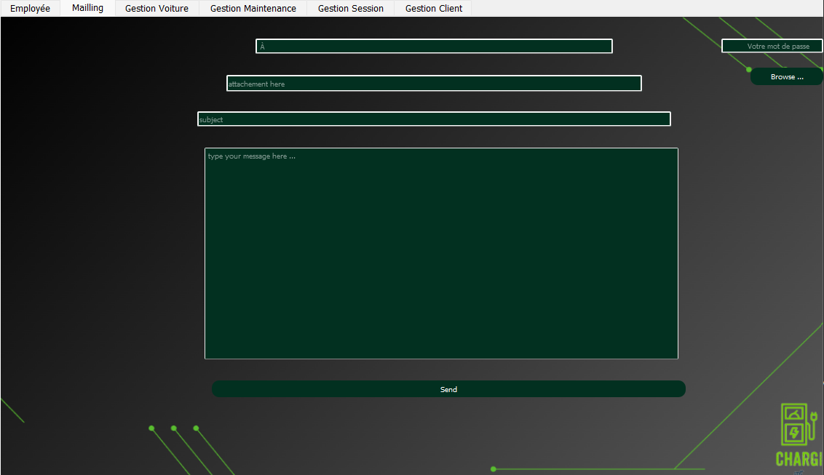
Employee Management :
/24

Slide 26
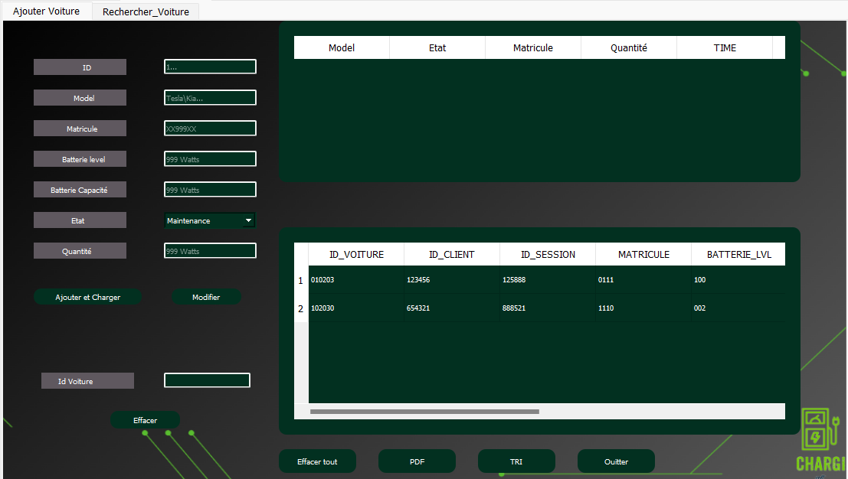
Car Management :
/25

Slide 27
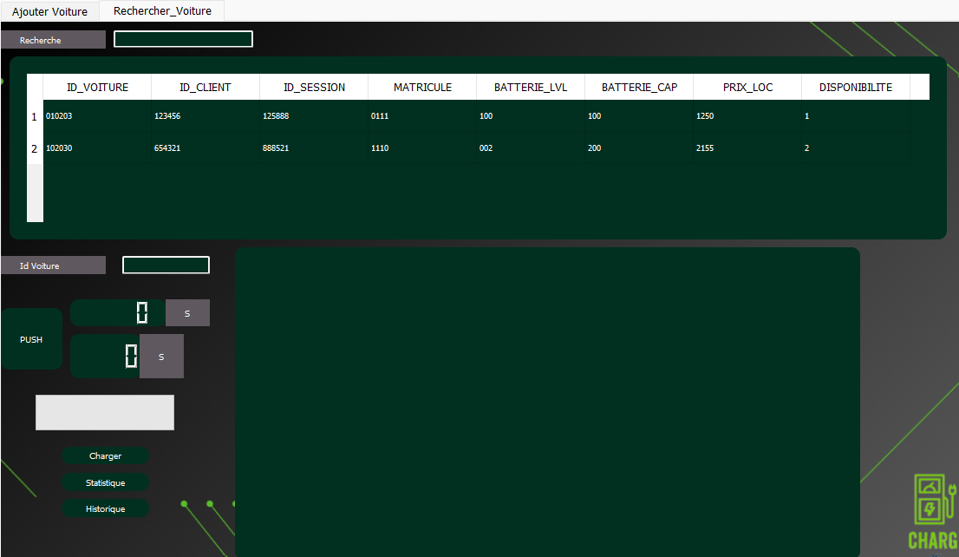
Car Management:
/26

Slide 28
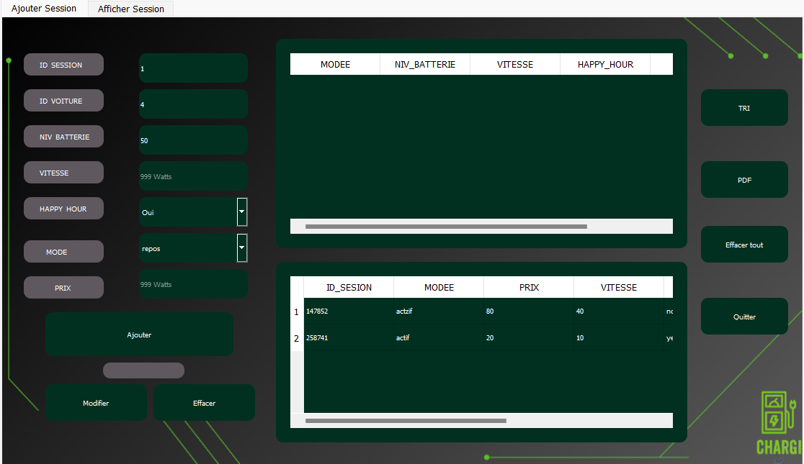
Ev charging Point Management:
/27

Slide 29
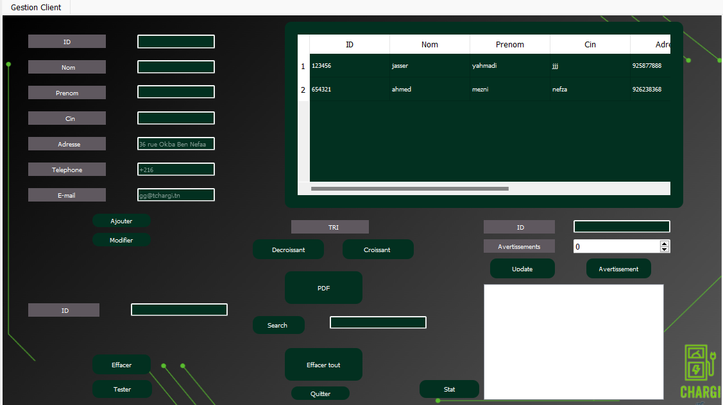
Client Management
/28

Slide 30
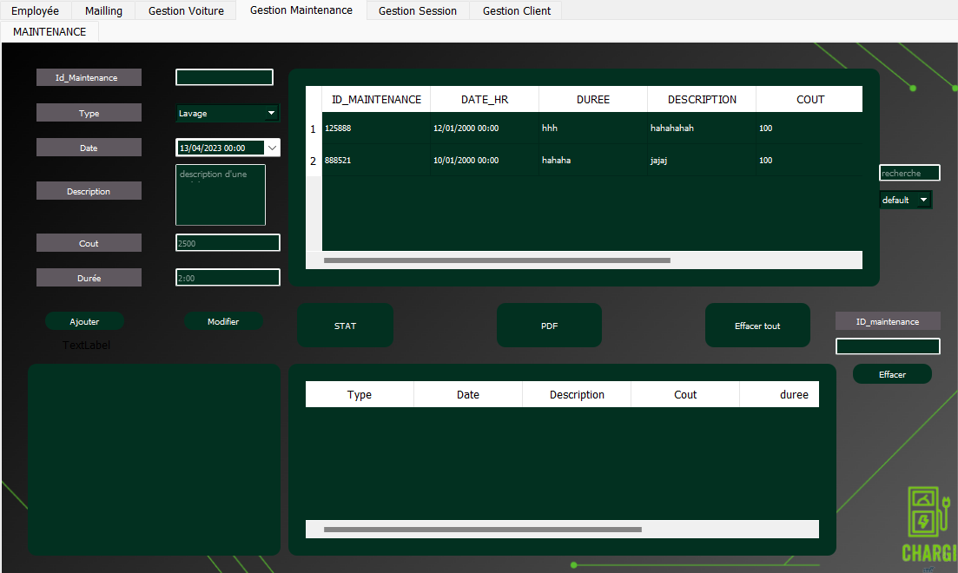
Maintenance Management :
/29

Slide 31
Perspective
As part of our continuous improvement approach, we have decided to add new features to the CHARGI application:
Facilitate user management by adding an account blocking and unblocking feature.
Optimize water usage in the electric vehicle washing process by enabling precise and measurable control of the water quantity used.
Furthermore, we plan to enhance our prototype to provide an even more intuitive and enjoyable user experience.
/30

Slide 32
Conclusion
-"CHARGI” is a complete Desktop application for managing vehicules charging
-It meets the needs of employees , cars , EV charging point , maintenance and complaints
-"CHARGI" stands out from the competition thanks to its unique added values .
-this application is essential in the rapidly growing market of software solution for electric vehicule charging management
/31

Slide 33






The SDGs Impacted
/32

Slide 34
THANKS!
Do you have any questions?
raslenferchihi1@gmail,com
+216 29775523
/33

